Slide 1


LSTM vs Transformer Encoder for AG News Text Classification
Term Project
Introduction to Deep Learning
Team:
Malik Muhammad Abdullah Hassan - 02621070
Syed Muhammad Shabih Ahmad – 02623026
Zain Shabbir – 02623024
Algorithmic Intelligence Laboratory

Slide 2
Table of Contents
Introduction and Motivation
Dataset and Preprocessing
Model Development
Main Comparison Results
Ablation Study
Failure Analysis
Conclusion

Slide 3
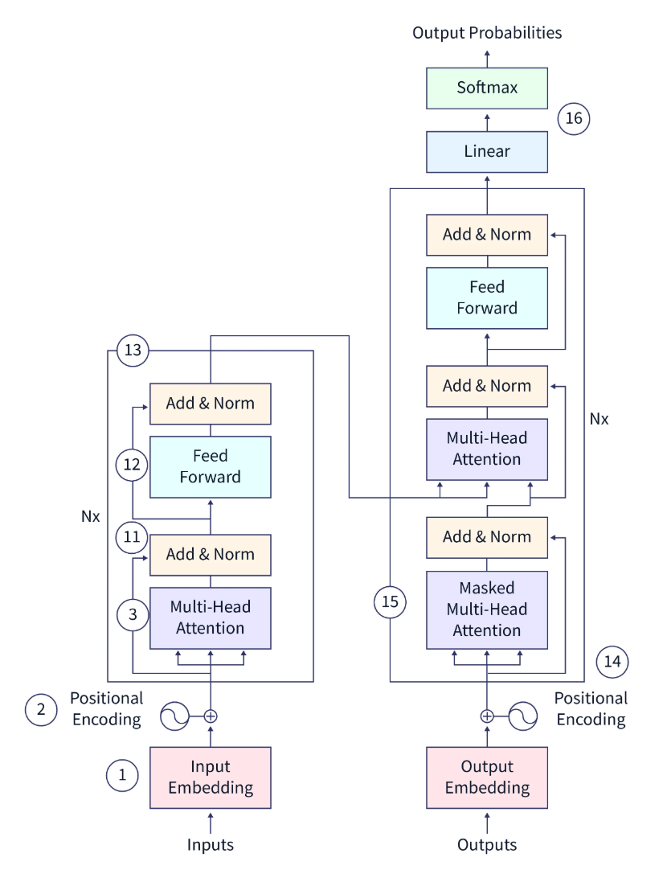
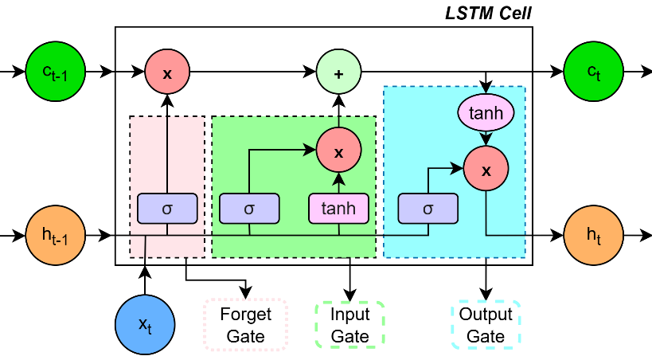
Introduction and Motivation
Why compare LSTMs and Transformer Encoder?
Both models are common sequence classifiers, but they process text differently.
The LSTM carries information recurrently through hidden states.
The Transformer Encoder uses self-attention to connect tokens directly.
The goal is to compare behavior, not only final accuracy.
LSTM
Transformer Encoder

Slide 4
Dataset
AG News is a news topic classification dataset.
Each example is a short text item, and the label is one of four classes:
World
Sports
Business
Sci/Tech
We sourced the dataset from Hugging Face exclusively.
Split | Source | Samples | Use
Train | 90% of official training split | 108,000 | Model fitting and train-only vocabulary construction
Validation | 10% of official training split | 12,000 | Model selection, ablation comparison, and interpretation
Test | Official test split | 7,600 | Final evaluation only

Slide 5
Preprocessing
Both models receive text after the same preprocessing pipeline:
Raw text is lowercased and tokenized with a regular expression tokenizer.
A vocabulary is built from training text only.
The vocabulary is capped at 20,000 entries.
Two reserved tokens are used:
<pad> at index 0.
<unk> at index 1.
Tokens are converted to integer IDs.
Sequences are truncated or padded to a fixed maximum length.
An attention mask marks real tokens as 1 and padding positions as 0.

Slide 6
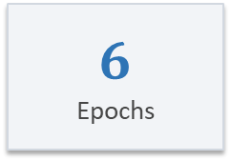
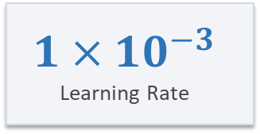
Model Development
LSTM: embedding layer, one-layer bidirectional LSTM, masked mean pooling, dropout, classifier.
Transformer Encoder: embeddings, learned positional encoding, two encoder layers, four heads, classifier.
Trainable parameters: LSTM 2.83M; Transformer Encoder 2.97M.
Both models are trained from scratch.
2.83M
LSTM parameters
2.97M
Transformer parameters
Important Hyperparameters:
Adam
Optimizer
$$1×{10}^{−3}$$
Learning Rate
$$6$$
Epochs
CrossEntropyLoss
Loss Function

Slide 7
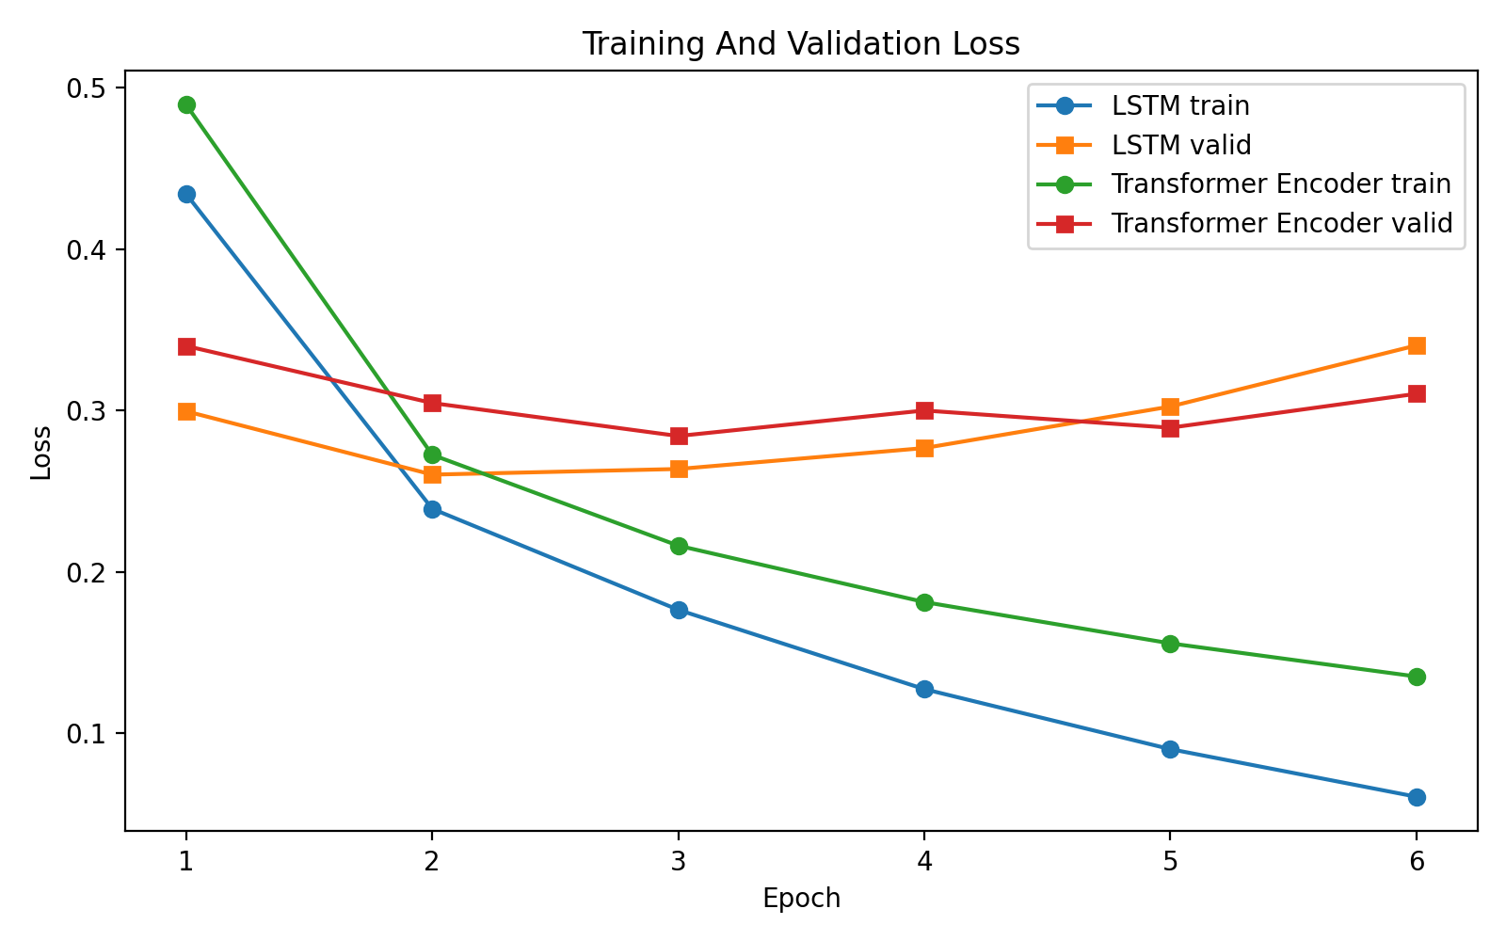
Main Results
The Transformer Encoder has the best final test metrics, but the margin is small:
Accuracy lead: 0.0005, or 0.05 percentage points.
Macro F1 lead: about 0.0008.
Both models perform very similarly. The Transformer Encoder is slightly ahead in this run, but the result is not a decisive architectural win.
Model | Split | Loss | Accuracy | Macro F1
LSTM | Validation | 0.3402 | 0.9113 | 0.9108
Transformer Encoder | Validation | 0.3103 | 0.9118 | 0.9115
LSTM | Test | 0.3459 | 0.9120 | 0.9118
Transformer Encoder | Test | 0.3066 | 0.9125 | 0.9126

Slide 8
Main Results
Training loss continues to decrease across 6 epochs.
Validation loss rises late in training.
This suggests early stopping or stronger regularization as the logical next improvement.

Slide 9
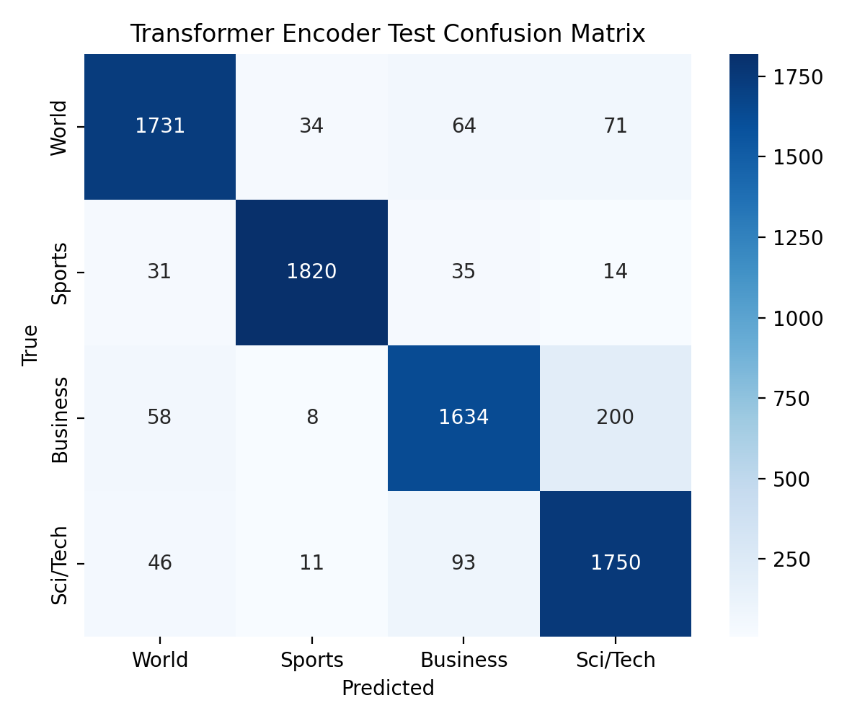
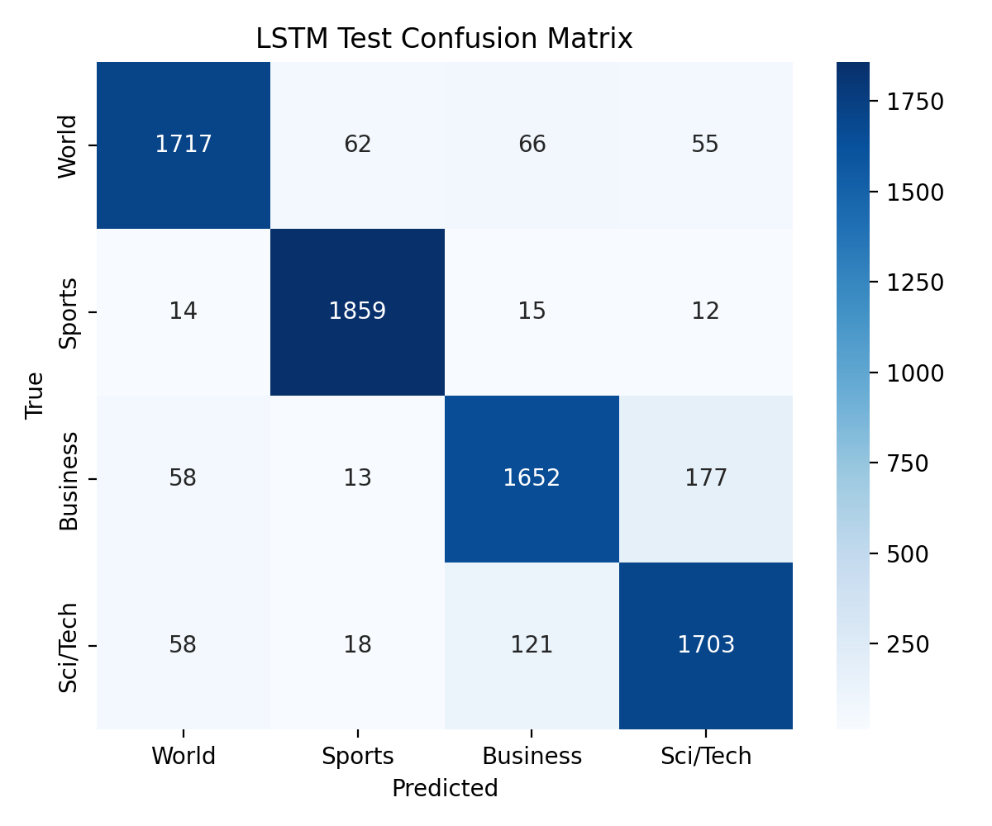
Main Results
Sports is the easiest class for both models.
Business and Sci/Tech overlap because many company stories include technology terms.
LSTM: 177 Business examples predicted as Sci/Tech, and 121 Sci/Tech examples predicted as Business.
Transformer Encoder: 200 Business examples predicted as Sci/Tech, and 93 Sci/Tech examples predicted as Business.
The pattern is consistent with the selected failure examples.

Slide 10
Ablation Studies
Two Ablation Studies were run:
Variable Training Set Fraction – 25%, 50%, 100%
Variable Sequence Length – 128, 256
Training Set Fraction
Sequence Length
Model | Train fraction | Accuracy | Macro F1
LSTM | 25% | 0.8719 | 0.8713
Transformer Encoder | 25% | 0.8699 | 0.8696
LSTM | 50% | 0.8944 | 0.8940
Transformer Encoder | 50% | 0.8901 | 0.8895
LSTM | 100% | 0.9089 | 0.9082
Transformer Encoder | 100% | 0.9146 | 0.9142
Model | Max length | Loss | Accuracy | Macro F1
LSTM | 128 | 0.3402 | 0.9113 | 0.9108
Transformer Encoder | 128 | 0.3103 | 0.9118 | 0.9115
LSTM | 256 | 0.3535 | 0.9065 | 0.9058
Transformer Encoder | 256 | 0.3304 | 0.9062 | 0.9059
25% data, LSTM is slightly better.
50% data, LSTM is still better.
100% data, Transformer Encoder is better.
LSTM is more stable in lower-data settings, while the Transformer Encoder benefits more from the full dataset.
However, the differences are modest, so the result should be described as a trend rather than universal proof from this result.
No improvement going from 128 to 256. Both models performed worse at 256 tokens.
Likely, AG News texts are short enough that 128 tokens already capture the useful signal.
Longer sequences increase computation and may introduce noisy or weakly useful tokens.

Slide 11
Failure Analysis
# | Input excerpt | True | LSTM | Transformer | Likely reason
1 | Live: Olympics day four Richard Faulds and Stephen Parry are going fo... | World | Sports | Sports | Sports terms dominate the short text even though the dataset section is World.
2 | Intel to delay product aimed for high-definition TVs SAN FRANCISCO --... | Business | Sci/Tech | Sci/Tech | A technology company story overlaps Business and Sci/Tech vocabulary.
3 | Prediction Unit Helps Forecast Wildfires (AP) AP - It's barely dawn w... | Sci/Tech | World | Sci/Tech | Weather prediction language mixes science terms with world-event framing.
4 | Some People Not Eligible to Get in on Google IPO Google has billed it... | Sci/Tech | Business | Sci/Tech | Finance and technology cues conflict; the IPO framing points toward Business.
5 | Teenage T. rex's monster growth Tyrannosaurus rex achieved its massiv... | Sci/Tech | Sci/Tech | Business | Very short science item gives limited context; the Transformer overweighs business-like wording.
6 | IBM to hire even more new workers By the end of the year, the computi... | Sci/Tech | Sci/Tech | Business | Company hiring story overlaps labor/business cues and computing-company Sci/Tech label.
Surface cues can dominate the true news section. For example, an Olympics-related text labeled World was predicted as Sports by both models.
Business and Sci/Tech overlap heavily when a story discusses a technology company, IPO, chip delay, software company, or computing-related business event.
Short science or technology items can be ambiguous because there is less context for the model to average over.

Slide 12
Conclusion
Both models reach about 91.2% final test accuracy.
The Transformer Encoder is slightly better on final test accuracy and macro F1.
The LSTM is stronger at 25% and 50% training data.
The Transformer Encoder benefits more at 100% training data.
Increasing max sequence length from 128 to 256 hurts validation performance in this run.
The main error pattern is Business vs Sci/Tech ambiguity.
Both models show overfitting by the final epoch.
Future work: early stopping, regularization, and class-level error reduction.

Slide 13
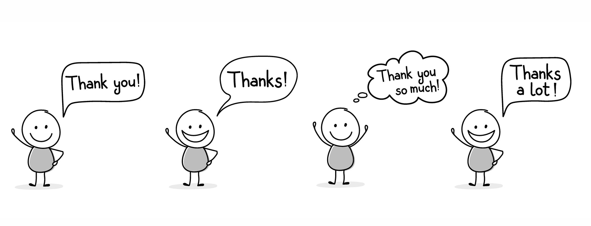
Algorithmic Intelligence Laboratory

